Slide 1


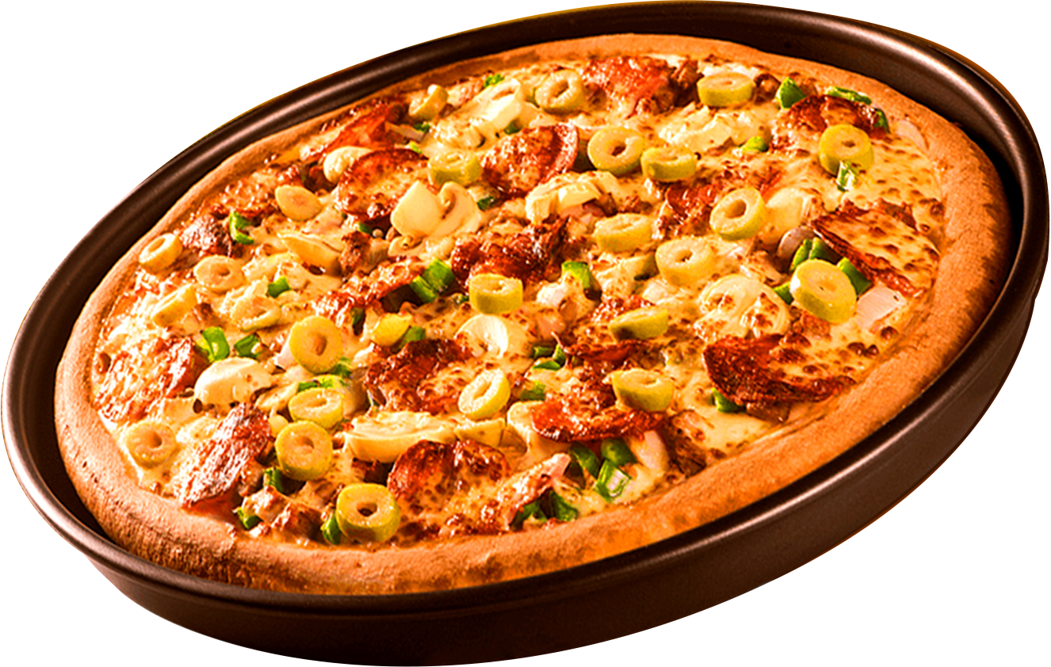
Where Every Slice Tells a Data Story
WELCOME TO
PIZZA SALES ANALYSIS
Utilizing SQL to extract insights
, solve business problems, and
support data-driven decisions.
Report By Khushi Nigam

Slide 2
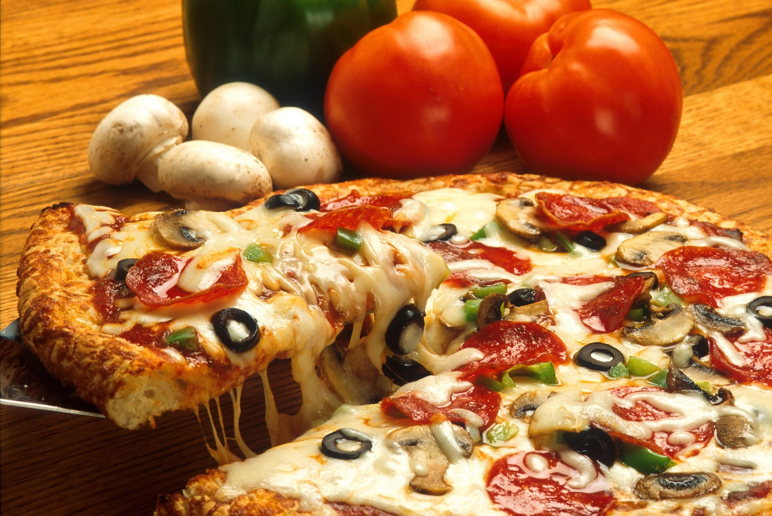

ABOUT THE PROJECT
In this project, I have analyzed a fictional pizza restaurant's sales database using SQL to extract valuable business insights. The dataset includes detailed information about customer orders, pizza categories, sizes, prices, and timestamps.
The main objective of this project was to:
Understand business performance through data
Answer real-world questions using SQL queries
Explore customer preferences and product demand
Support data-driven decisions for better strategy planning

Slide 3
Through structured query language (SQL), I handled various queries ranging from simple data retrieval to advanced aggregations and joins. The analysis was categorized into three levels — Basic, Intermediate, and Advanced — to demonstrate problem-solving skills at each stage.
This project is a practical demonstration of how SQL can be used to drive meaningful insights and support decision-making in a business environment

Slide 4
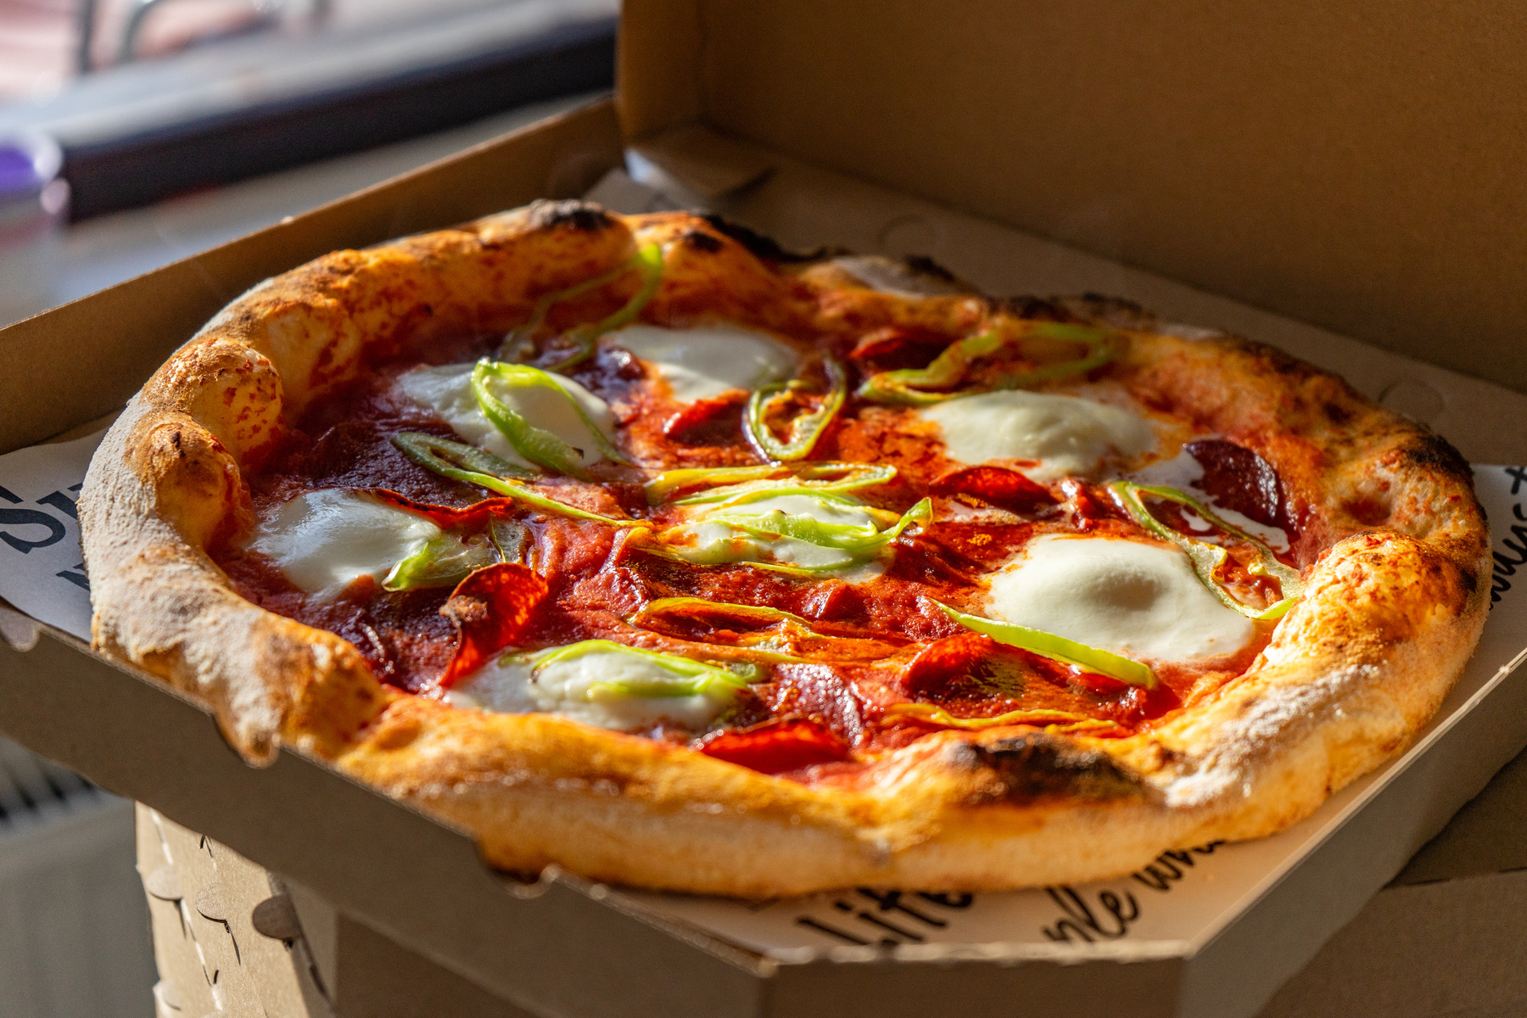
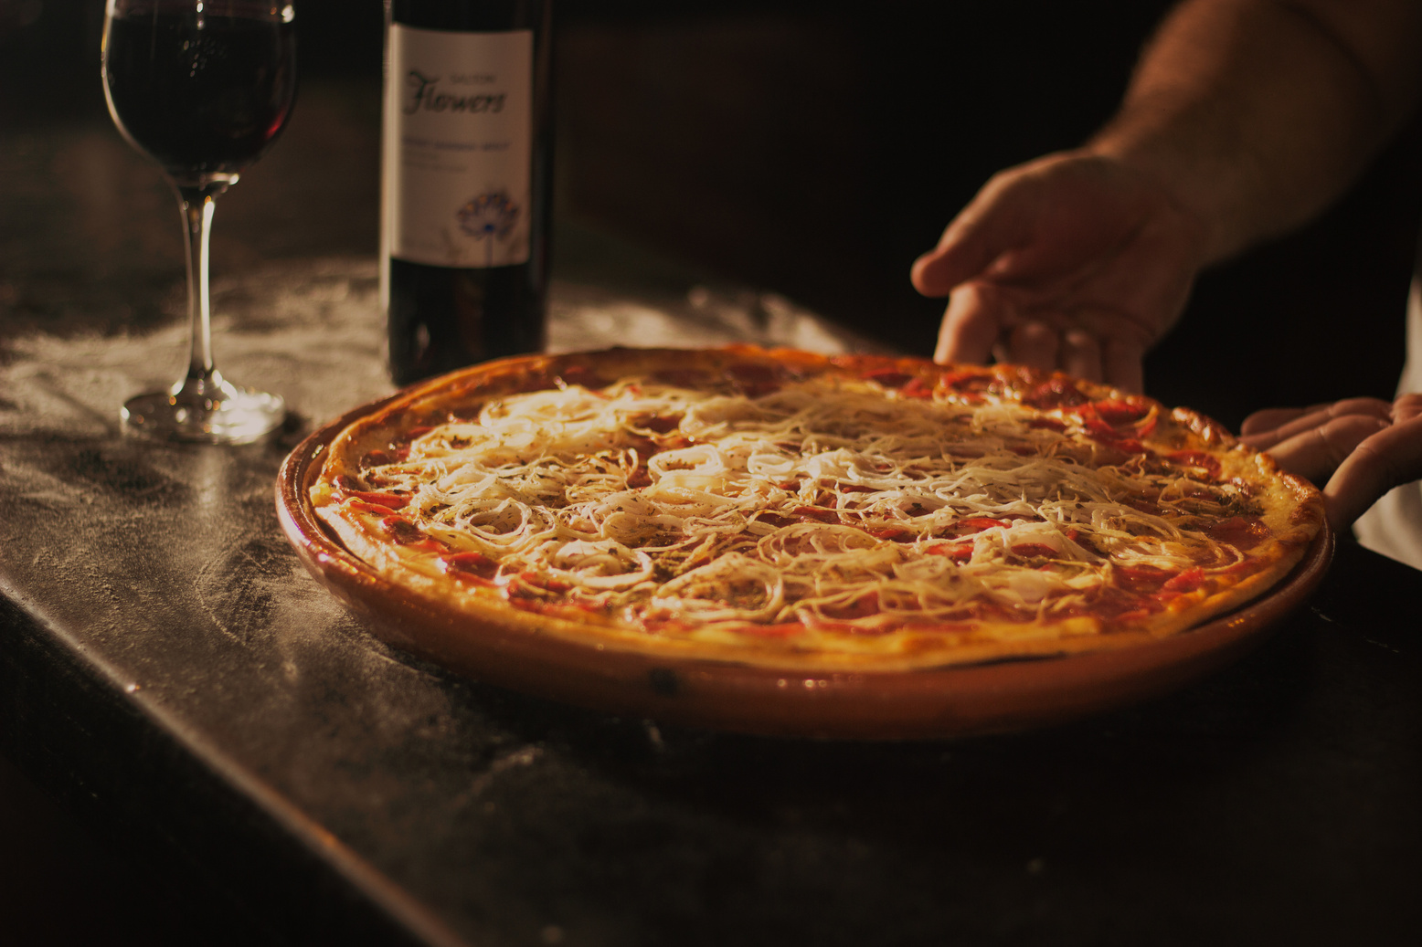
SQL QUERIES COVERED
Total number of orders placed
Total revenue from sales
Highest-priced pizza
Most common pizza size
Top 5 most ordered pizza types with quantities
Top 3 pizzas by revenue within each catego
Pizza category-wise quantity (using joins)
Revenue % contribution per pizza type
Cumulative revenue over time
Order distribution by hour
Category-wise pizza distribution
Daily average pizza orders
Top 3 pizzas by revenue

Slide 5
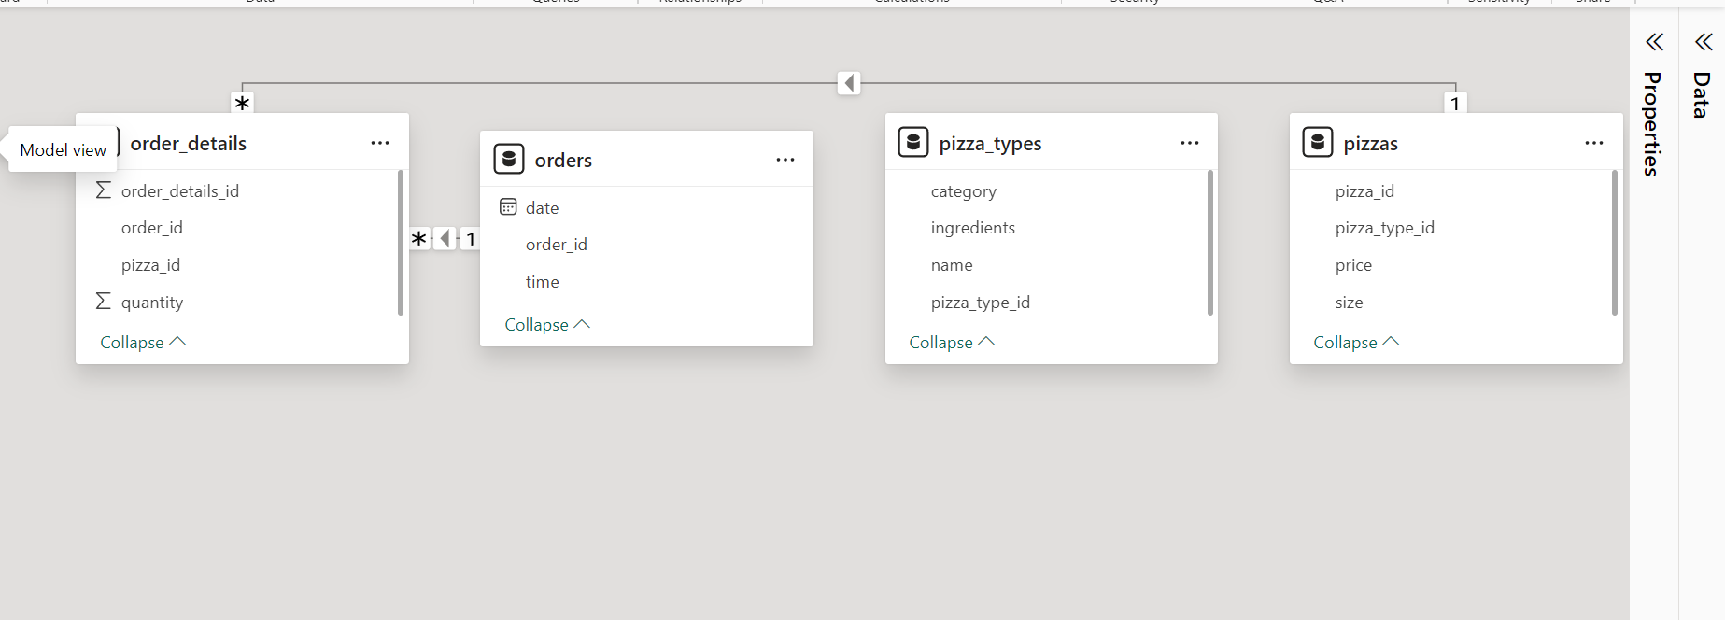
MODEL VIEW

Slide 6
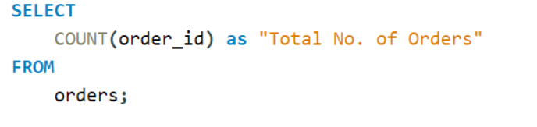
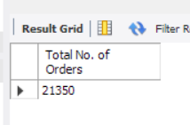
RETRIEVE THE TOTAL NUMBER OF ORDERS PLACED.

Slide 7
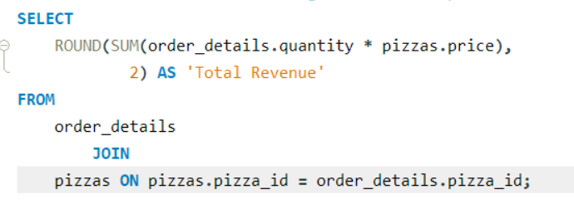
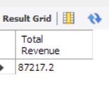
CALCULATE THE TOTAL REVENUE GENERATED FROM PIZZA SALES.

Slide 8
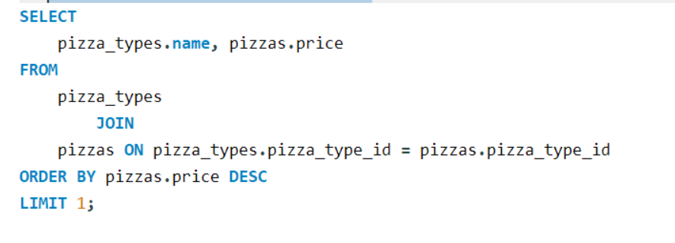
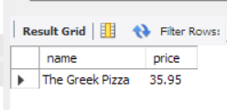
IDENTIFY THE HIGHEST-PRICED PIZZA.

Slide 9
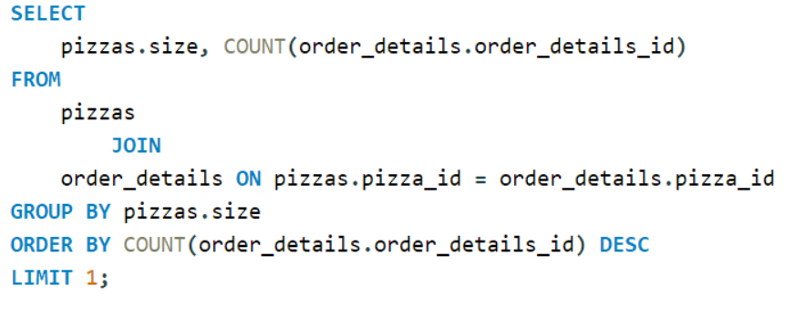
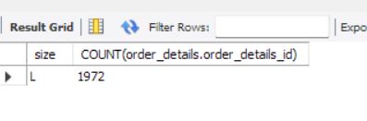
IDENTIFY THE MOST COMMON PIZZA SIZE ORDERED.

Slide 10
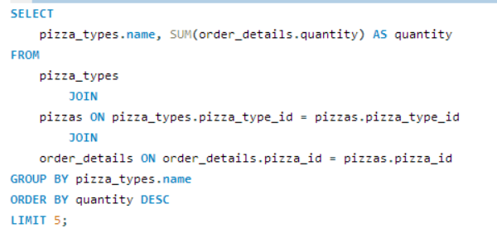
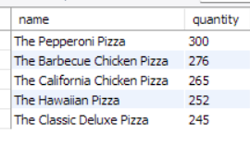
LIST THE TOP 5 MOST ORDERED PIZZA TYPES ALONG WITH THEIR QUANTITIES.

Slide 11
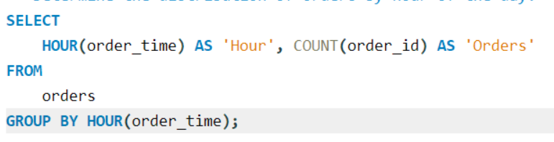
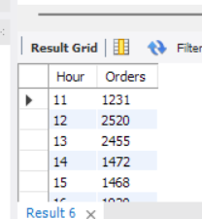
DETERMINE THE DISTRIBUTION OF ORDERS BY HOUR OF THE DAY

Slide 12
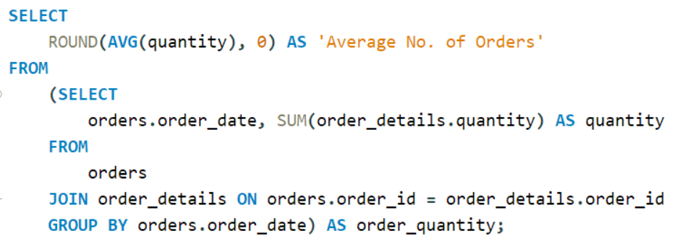
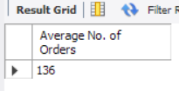
GROUP THE ORDERS BY DATE AND CALCULATE THE AVERAGE NUMBER OF PIZZAS ORDERED PER DAY.

Slide 13
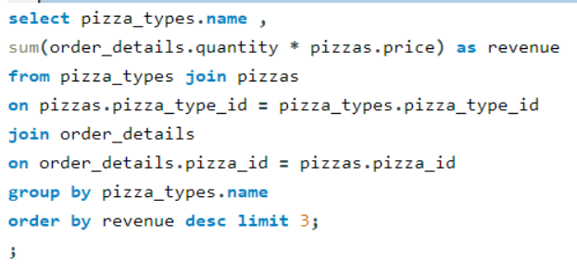
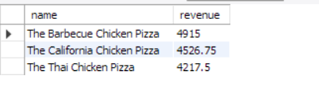
DETERMINE THE TOP 3 MOST ORDERED PIZZA TYPES BASED ON REVENUE.

Slide 14
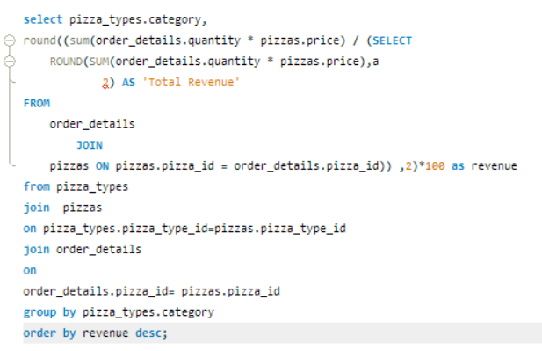
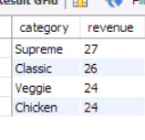
CALCULATE THE PERCENTAGE CONTRIBUTION OF EACH PIZZA TYPE TO TOTAL REVENUE.

Slide 15
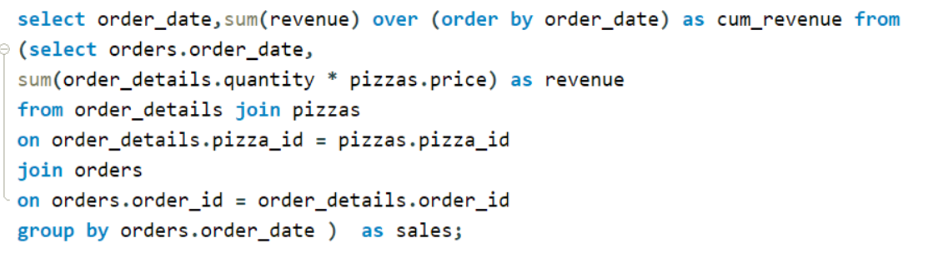
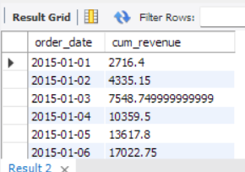
ANALYZE THE CUMULATIVE REVENUE GENERATED OVER TIME.

Slide 16
THANK YOU
For viewing my project on Pizza Sales Analysis using SQL
Feel free to ask any questions !

